Slide 1



Database System Vs File System Session No.: 02 Course Name: DBMS Course Code: E2UC302B Instructor Name: Dr. Anil Sharma
Galgotias University Students-Centred Active Learning Ecosystem

Slide 2
Review of Previous Lecture
Overview of the database management system
Any doubts from these previous class topics?
Galgotias University Students-Centred Active Learning Ecosystem

Slide 3


“Imagine your college stores student data, exam records, and fee payments in separate Excel files. What problems might arise when generating a report for a student’s complete profile?”
Galgotias University Students-Centred Active Learning Ecosystem

Slide 4
At the end of this session students will be able to :
LO1: Define the concept and structure of a File Processing System (FPS).
LO2: Recognize real-world applications where DBMS is more appropriate than FPS..
Galgotias University Students-Centred Active Learning Ecosystem
03.03.2025

Slide 5
Session Outline
1 File System: Introduction
2 Key Features
3 Limitations
4 Comparison between File System & DBMS
Galgotias University Students-Centred Active Learning Ecosystem

Slide 6
File Processing System (FPS)
Definition: A file system is a method of organizing files on a storage medium (like a hard drive).
Function: It manages files, directories, and their access permissions.
Advantages:
• Simple and easy to implement
• Low cost of maintenance
• Suitable for small-scale applications
• Provides basic file and directory management
• Works across all major operating systems
Galgotias University Students-Centred Active Learning Ecosystem

Slide 7
File Processing System (FPS) contd..
Disadvantages:
• High data redundancy and inconsistency
• Difficult to maintain data integrity
• No support for concurrent access
• Poor security and access control
• No built-in backup or recovery mechanism
• Limited scalability for large datasets
Galgotias University Students-Centred Active Learning Ecosystem

Slide 8
Database Management System
A Database Management System is software designed to define, create, manage, and control access to a database.
It abstracts the details of data storage and offers structured, efficient, and secure mechanisms to store and retrieve data.
DBMS features include query processing (e.g., via SQL), transaction management, concurrency control, recovery mechanisms, security enforcement, and metadata dictionaries.
Galgotias University Students-Centred Active Learning Ecosystem

Slide 9
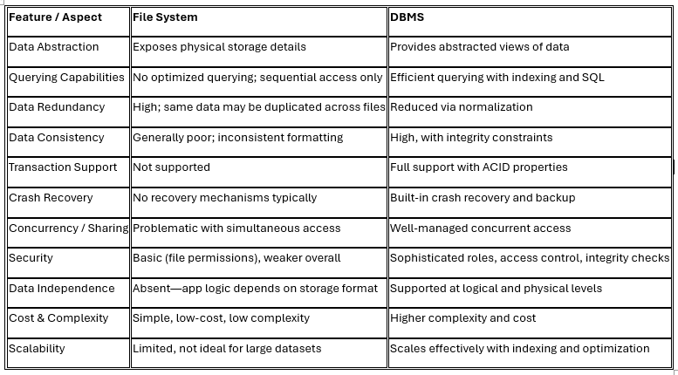
File System Vs Database Management System
Galgotias University Students-Centred Active Learning Ecosystem

Slide 10

Learning Activity 1: Think Pair Share (use wooclap)
Roll_No Name Age Email201 Anu 19 anu@gmail.co
1. Individually think about:
Each student receives a small card/slip (or digital version) with one feature written on it. (e.g., “Data Redundancy: High”, “Uses SQL”, “Centralized Access”, “Difficult to Scale”, “Supports Concurrency”, “Difficult Data Sharing”, “Data Security: Manual”, “Backup: Manual”, “Multi-user Access"). Each student to individually think about the system their feature belongs to: File System or DBMS.
2. Pair up to compare answers: Students form pairs (or groups of 3). They share and discuss their assigned features.
3. Share their findings with the whole class:: Select a few pairs to share one or two features each with the whole class. As they share, the teacher validates or corrects the classification and gives brief reasoning.
Galgotias University Students-Centred Active Learning Ecosystem

Slide 11
Case Study: Data Management Challenges in an E-Commerce Company
Scenario: ShopXpress is a fast-growing e-commerce company operating across multiple cities in India. The company has several warehouses, each maintaining its own records of stock, orders, and shipments. Currently, ShopXpress uses a traditional File Processing System (FPS) to manage its data. Each department (inventory, shipping, sales, etc.) maintains separate files in Excel and text formats. Pair up to compare answers.
The Problem:
As the company expands, it begins to face serious issues:
Inventory counts are inconsistent across warehouses.
Customers receive wrong or delayed deliveries due to outdated records.
Departments often duplicate data, leading to confusion and wasted storage.
Generating a consolidated sales report across all regions takes hours.
Unauthorized users have accidentally modified sensitive files.
The system cannot handle a sudden spike in data (e.g., during festive sales).
Galgotias University Students-Centred Active Learning Ecosystem

Slide 12
Case Study: Data Management Challenges in an E-Commerce Company
Management Concern:
The leadership team is concerned about the reliability and scalability of their data management system. They are now considering shifting to a Database Management System (DBMS) to resolve these issues.
What the students will do:
As a team of IT consultants, your task is to:
Analyze the current challenges faced by ShopXpress due to the use of FPS.
Compare FPS and DBMS in the context of this scenario.
Galgotias University Students-Centred Active Learning Ecosystem

Slide 13


Learning Activity 2: Case Study
Recommend whether ShopXpress should continue with FPS or migrate to a DBMS.
Support your recommendation with technical reasons (e.g., data consistency, scalability, concurrency, security, etc.).
Galgotias University Students-Centred Active Learning Ecosystem

Slide 14
Summary
File System = Simple, but limited and outdated
DBMS = Efficient, secure, scalable, and preferred
Modern applications rely on DBMS for scalable, reliable systems
Galgotias University Students-Centred Active Learning Ecosystem

Slide 15
Next topic: Database system concept and architecture.
Galgotias University Students-Centred Active Learning Ecosystem

Slide 16
Post session activity: (Submit the answer through LMS)
ASSIGNMENT
Galgotias University Students-Centred Active Learning Ecosystem

Slide 17

Thank you…
Galgotias University Students-Centred Active Learning Ecosystem

